Slide 1

Hanabi
Shay Shwarz
Hodaya Binyamini

Slide 2


What is Hanabi?
Hanabi is a cooperative card game published in 2010.
Players can see other players' cards but not their own.
Players attempt to play a series of cards in a specific order to set off a simulated fireworks show.
Players are limited in the types of information they may give to other players, and in the total amount of information that can be given during the game.

Slide 3
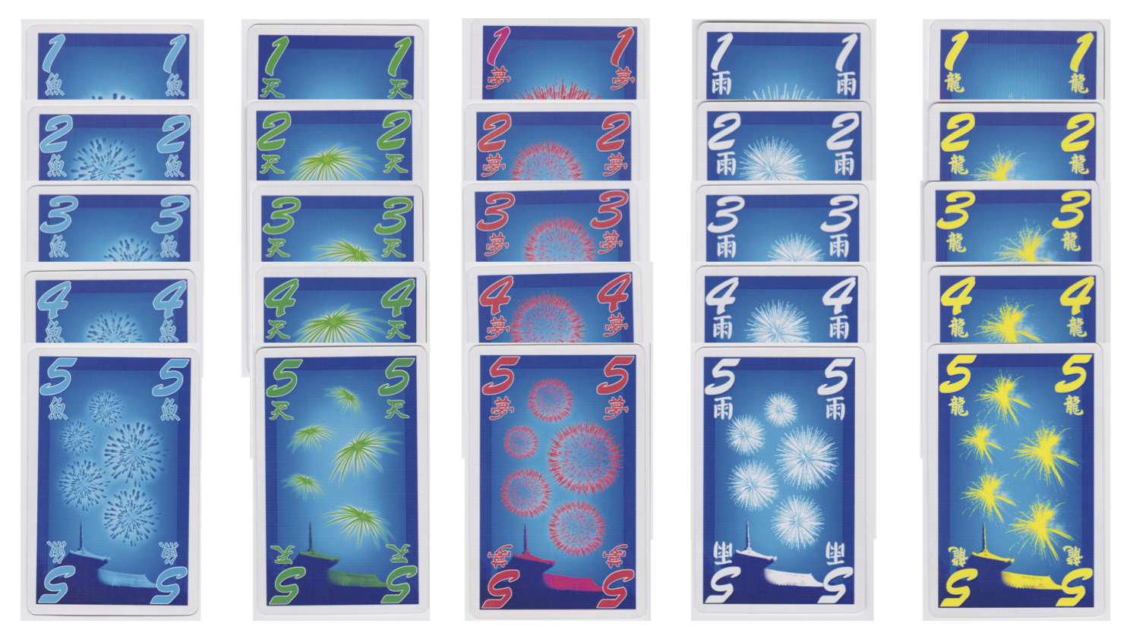
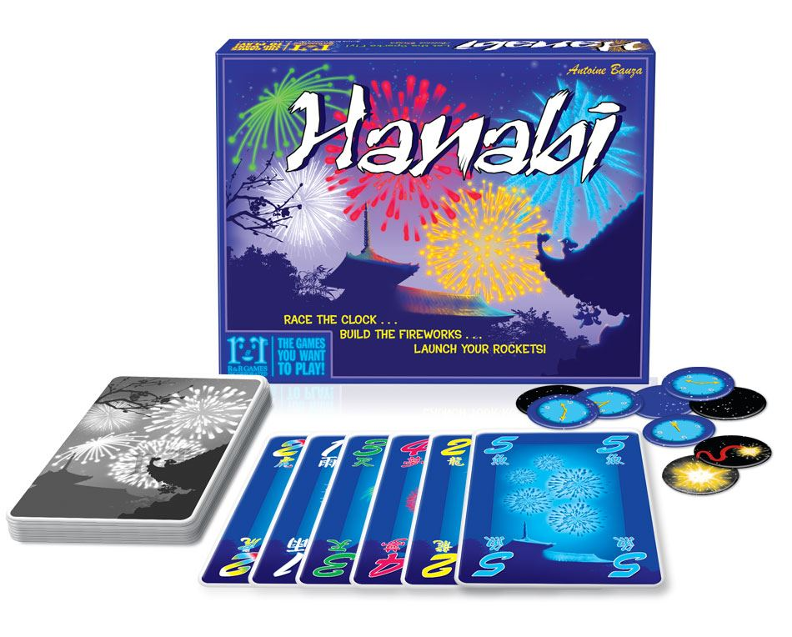
What is Hanabi?
The game:

Slide 4
How to play Hanabi? (Classic variant)
Players cannot see their own cards but can see the other player’s cards.
The goal of the group is to make series from 1 to 5 in every color.
In each player’s turn, the player can:
spend an information token to tell another player about a feature (color or value) of the cards they have.
2. discard a card from his hand (and get an info token in return)
3. choose to play a card from his hand
When playing a card players must try to play a card which is consecutive to the card in play with the same color.
Failing to play a proper card result in a strike.
3 strikes ends the game.
The group wins if all stacks are complete (corresponding to a score of 25).

Slide 5
Previous Work
There are numerous works in the Game Theory field based on the Hanabi card game.
The Hanabi game was proven to be NP-complete (even for cheaters who look at their cards)**.
**Baffier, J. F., Chiu, M. K., Diez, Y., Korman, M., & Mitsou, V. (2016). Hanabi is NP-complete, even for cheaters who look at their cards.‏

Slide 6
Previous Work
How to Make the Perfect Fireworks Display: Two Strategies for Hanabi (2015, Mathematics Magazine)**
In this paper:
A description of Hanabi strategies based on the mathematical “hat guessing game”.
In the first strategy players can recommend moves for other players (as part of a strategy).
The second strategy allows the player to determine the content of his hand.
Strategies are based on network coding.
**Cox, C., De Silva, J., Deorsey, P., Kenter, F. H., Retter, T., & Tobin, J. (2015). How to make the perfect fireworks display: Two strategies for hanabi. Mathematics Magazine, 88(5), 323-336.‏

Slide 7
Previous Work
Evolving Agents for the Hanabi 2018 CIG Competition (2018 IEEE Conference on Computational Intelligence and Games )**
In this paper:
The author developed a genetic algorithm that builds rule- based agents by determining the best sequence of rules from a fixed rule set to use as strategy.
The author defined 72 rules, every chromosome is permutation of this rules.
They used the operators of swap mutation and ordered crossover.
**Canaan, R., Shen, H., Torrado, R., Togelius, J., Nealen, A., & Menzel, S. (2018, August). Evolving Agents for the Hanabi 2018 CIG Competition. In 2018 IEEE Conference on Computational Intelligence and Games (CIG) (pp. 1-8). IEEE.‏

Slide 8
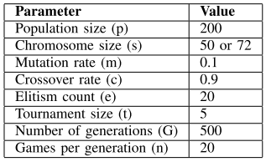
Previous Work
The parameters:
The average score of this agent:
mirror game: 19.32
mixed agents: 11.65

Slide 9
Our Goal
Develop an agent using genetic programming algorithm that can play the Hanabi game.
The model gets the game state: desk cards, discarded cards, players hands, info tokens, etc…
The output is the next action the player should preform.

Slide 10
Fitness Function
The Fitness function is simply running a simulation of a game N times and computing the average result.

Slide 11
Terminals and Primitives
In our GP tree a Primitive is a query about the current state of the game (from the current player’s point of view).
A Terminal in the tree is an action to be preformed.
As a start, we implemented the following simple Primitives and Terminals:
Has Playable card
Play a playable card
Play random card
Can tell info
Can tell about ones
Tell about ones
Discard oldest card with least info

Slide 12
GP Tree – an example
Has playable card
True
False
Play playable card
Can tell about ones
True
False
Tell about ones
Discard oldest card with least info

Slide 13
Simulation
We used a python EC library called DEAP ( Distributed Evolutionary Algorithm Programming).
Our Parameters for the first simulation:
Parameter | Value
Population | 30
Initial individuals | full trees of depth 4-10
Crossover | one point crossover, probability: 0.9
Mutation | uniform mutation, probability: 0.1
Selection | Tournament selection with parameter 7
Generations | 100
Notes:
Mutation - randomly select a point in the tree individual, then replace the subtree at that point

Slide 14
Initial Results
Notes:
Pop size = 30
Starter individual depth 4-10
Selection tournament selection with size 7
Cx one point crossover
Mutation
Ngenerations = 100
Cxpb 0.9
Mutpb 0.1

Slide 15
Future Work
Implement more queries and rules (which are described in previous papers).
Implement new rules and queries.
Change and experiment with various evolutionary parameters.
Run more simulations and compare them.

Slide 16

Questions?

Slide 17


